Slide 1
Progress Report
Researched on various pre built Opencv tracking modules for tracking the movement of the components.
Finally used CSRT technique, so that occulsions can be taken care of.
The reason to use this particular technique is that the architecture is somewhat similar to that of the algorithm mentioned in the research paper.
The dataset used is from A video dataset for wooden box assembly | Zenodo

Slide 2
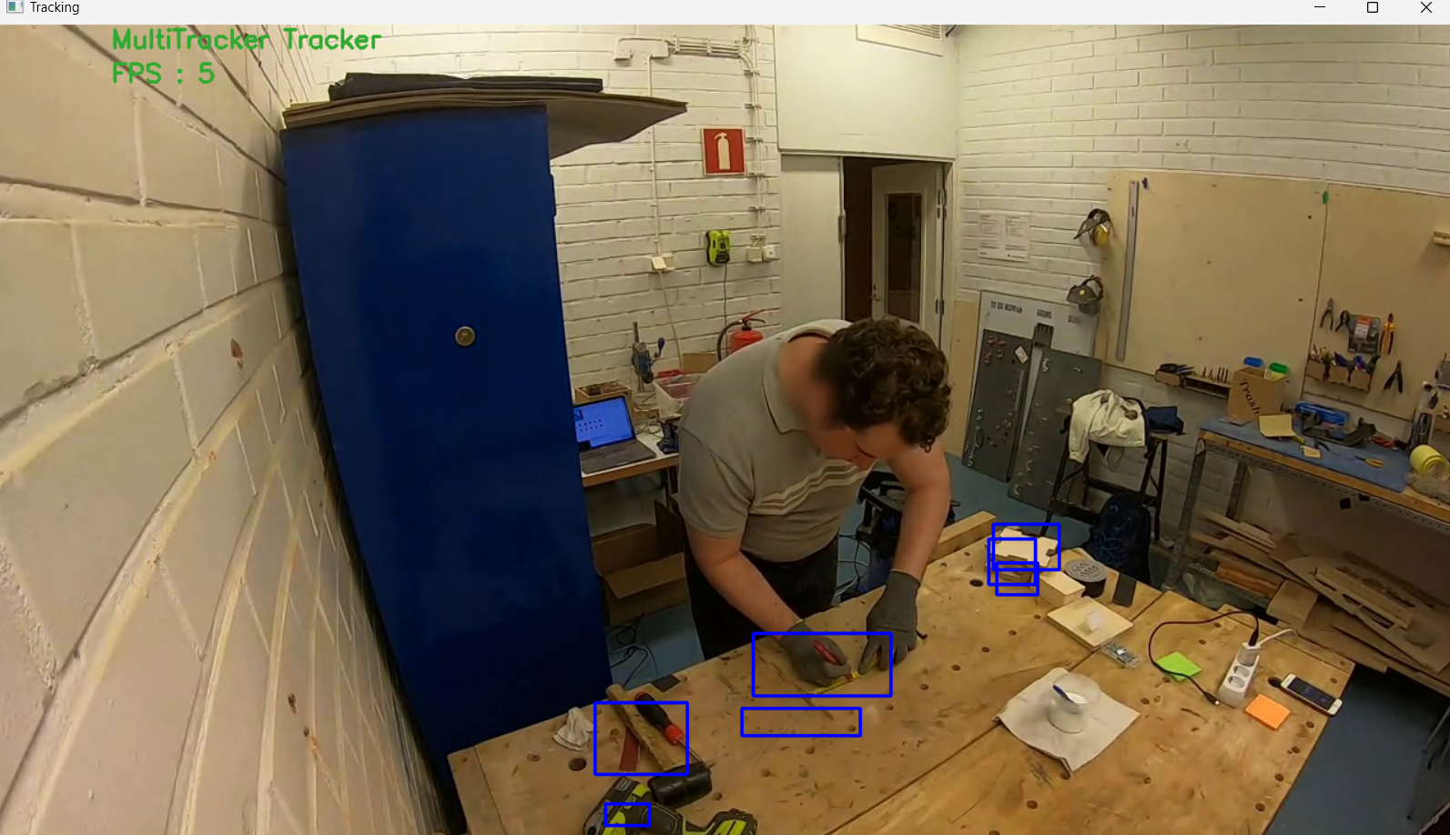
Marking the tools and Planks

Slide 3
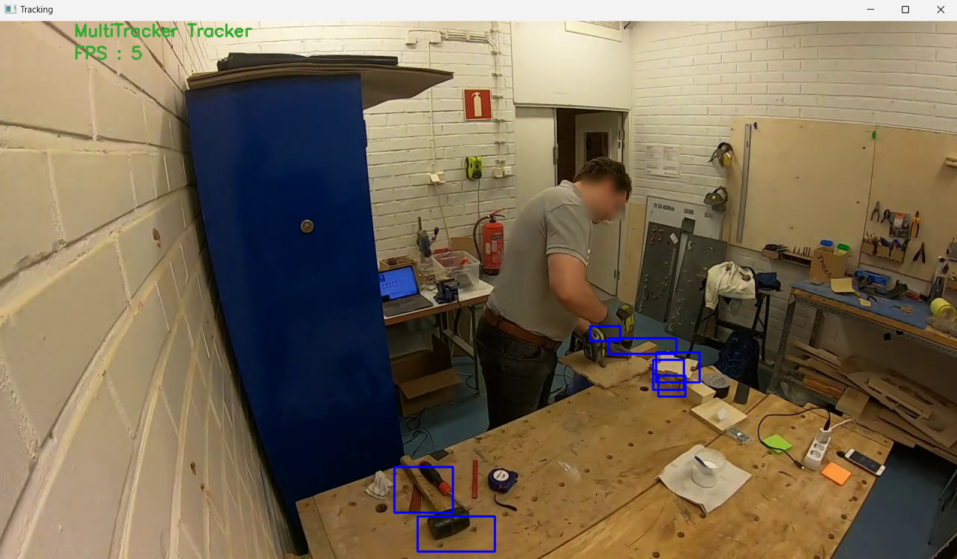
The Bounding Boxes following the components

Slide 4
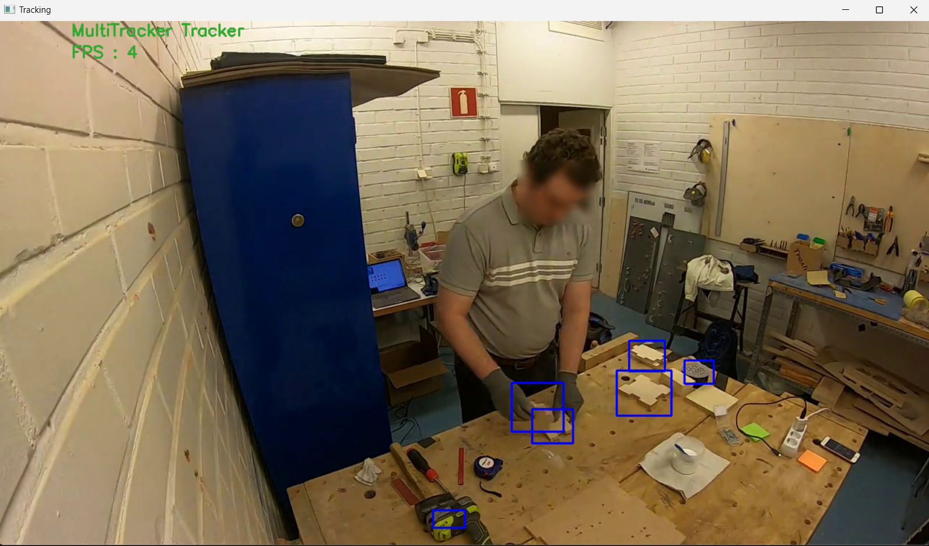
Agent joining the wooden planks along perforations

Slide 5


Slide 6
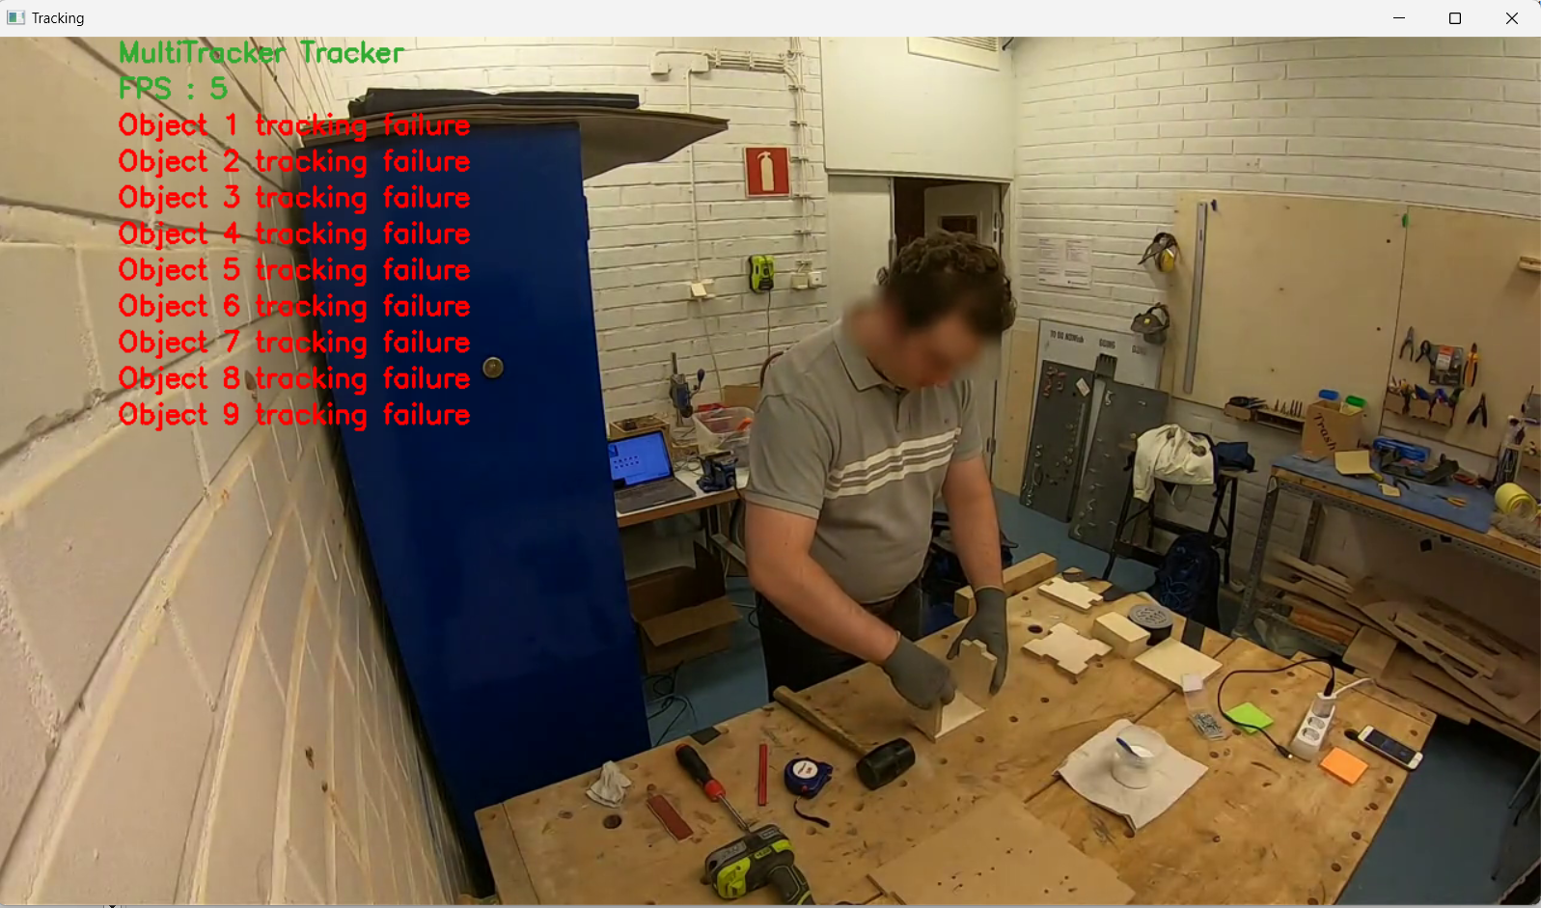
Code Breaking Point

Slide 7
Target for project
Develop the whole algorithm(research paper), and try to compare the result and robustness with the used model.
Train the model to identify components, so that it can identify the components (in this case wooden box) and capture the state.
After the above step, create an algorithm to make a graph of states observed.
After observing the most efficient path, our new model should ensure to generate the result on the same path.

